Slide 1
Community for Emerging and Zoonotic Diseases Identifying emerging risks through collective intelligence
CEZD – CAHSS Companion Animal Network Update
02 April 2024
www.cezd.ca

Slide 2
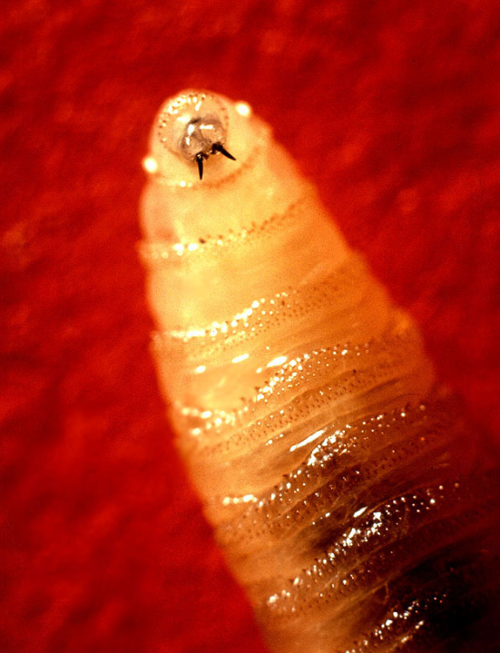
New World Screwworm in South America
Parasitic fly larva - Cochliomyia hominivorax causing wound myiasis
February 2024 – Costa Rica declared a sanitary emergency due to the presence and spread of new world screwworm; 203 cases have been treated in cattle, horses, pigs, sheep, goats and dogs
March 2024 – Costa Rica reports 1st human case in country
Panama has also reported 2 human cases, along with previous cases in cattle
Important to know travel history of companion animals
Notes:
New World Screwworm has been reported in Costa Rica and Panama
- the screwworm in a parasitic fly larva that cause wound myiasis
In February 2024 – Costa Rica declared a sanitary emergency due to the presence and spread of new world screwworm; 203 cases have been treated in cattle, horses, pigs, sheep, goats and dogs
March 2024 – Costa Rica reports 1st human case in country
And I believe last week, Panama also reported 2 human cases, along with previous cases in cattle
Uruguay is developping a CRISPR gene drive to eradicate the New World screwworm, as sterile fly releases have been used to eradicate them in the past, and in central America they are now overwhelmed, the infectious burden is too great for sterile fly releases to be successful.

Slide 3
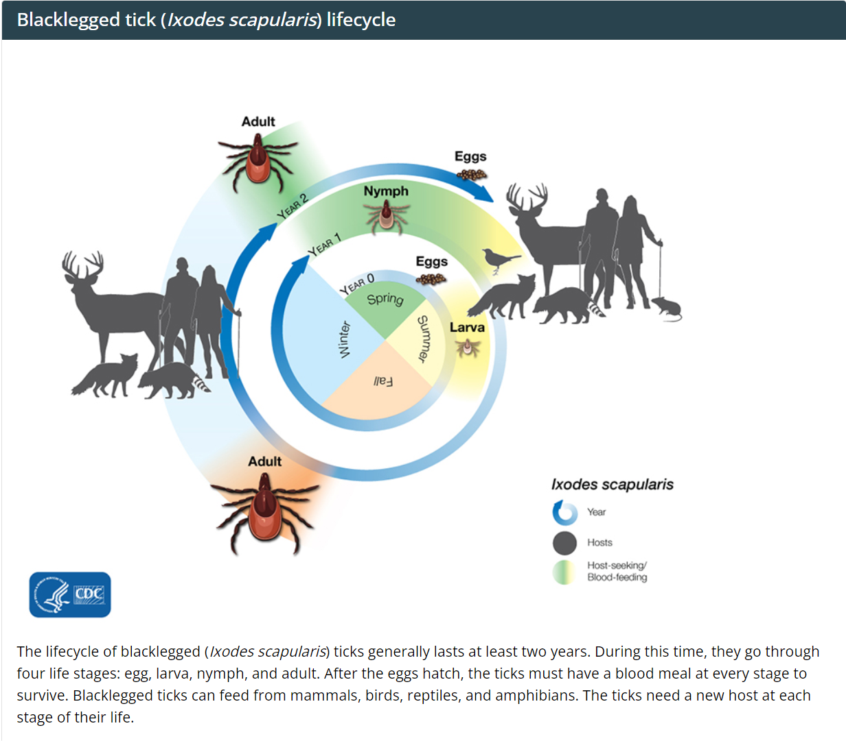
Lyme Disease & related info in Canada
The number of black-legged ticks is increasing in Saskatchewan
Northwest Territories report finding their first blacklegged tick positive for Borrelia burgdorferi – on a pet dog recently arrived to Fort Simpson
Multiple reports of earlier tick findings this year in US and Canada due to mild winter
Blacklegged tick (Ixodes scapularis) surveillance | Ticks | CDC
Female ticks (Ixodes scapularis) infected with Borrelia burgdorferi have increased overwintering survival, with implications for tick population growth
Unfed adult female ticks infected with B. burgdorferi have greater overwintering survival than uninfected female tick
Infection appears to correlate with super cooling point as those ticks that are infected froze at a lower temperature then those not infected (infection makes ticks more cold resistant)
B. burgdorferi infection may be promoting the northern range expansion of I. scapularis, in addition to climate change
Study highlights how pathogens could work synergistically with climate change to promote host range
Notes:
The number of black-legged ticks is increasing in Saskatchewan, and due to warmer winters, tick activity may be longer than usual; scientists will also be looking to see if the tick populations have established in Saskatchewan
The Northwest Territories have reported their first finding of a blacklegged tick positive for Borrelia burgdorferi. The adult female black-legged tick was found on a pet dog in the Fort Simpson area, the dog had recently arrived from an endemic southern province. It is unclear whether the tick and/or the bacteria was locally acquired.
Multiple reports of earlier tick findings this year in US and Canada due to mild winter (in Ontario, Michigan…)
Also of interest, is a recent finding of Borrelia burgdorferi increasing ticks ability to overwinter

Slide 4
Candida auris detected in the oral cavity of a dog in Kansas - PubMed (nih.gov)
1st identification of Candida auris in a non-human mammal the United States
C auris has been emerging since 2009 as a multidrug resistant infection in humans
Increasing trend of human infections since 2016
2023 US CDC sent out a warning about C. auris calling it an urgent antimicrobial resistance threat

Slide 5
Candida auris detected in the oral cavity of a dog in Kansas - PubMed (nih.gov)
Detection in one dog in Kansas
Study on oral mycobiome of dogs
1 dog had 4 fungal agents
Malassezia pachydermatis
C. albicans
C. glabrata
C. auris
Uncertain source of infection for the dog
No clinical disease described in the paper
No transmission to humans or animals was found
C. auris has not been reported in humans in Kansas

Slide 6
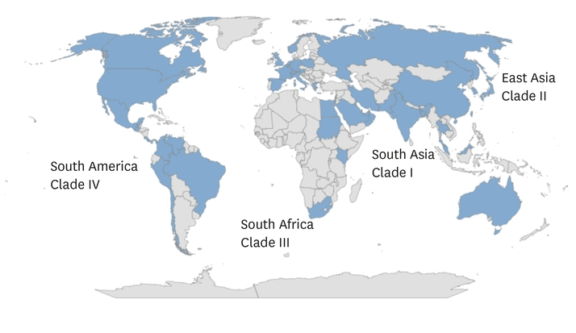
Candida auris detected in the oral cavity of a dog in Kansas - PubMed (nih.gov)
In US most isolates are usually Clade I and II
This one was Clade IV (South American)
Found to be resistant to fluconazole, terbinafine, and amphotericin B but susceptible to caspofungin
Consistent with those isolates found in human cases
Question: Are clinicians looking for C. auris in companion animals?
Are multi drug resistant fungal infections occurring in Canada

Slide 7
Scientific Publications of Interest
Salmonella Vitkin Outbreak Associated with Bearded Dragons, Canada and United States, 2021–2022 - Volume 30, Number 2—February 2024 - Emerging Infectious Diseases journal – CDC
Alveolar Echinococcus in a 70-year-old man in Ontario | Journal of the Association of Medical Microbiology and Infectious Disease Canada (utpjournals.press)
Costa Rica declares sanitary emergency for animal parasites - Prensa Latina (plenglish.com)
Recent Changes in Patterns of Mammal Infection with Highly Pathogenic Avian Influenza A(H5N1) Virus Worldwide - Volume 30, Number 3—March 2024 - Emerging Infectious Diseases journal – CDC
The dog as a sentinel and animal model for coccidioidomycosis - PubMed (nih.gov)
Emergence of Thelaziosis Caused by Thelazia callipaeda in Dogs and Cats, United States - Volume 30, Number 3—March 2024 - Emerging Infectious Diseases journal – CDC
Whole-genome sequencing of SARS-CoV-2 from the initial cases of domestic cat infections in Canada - PubMed (nih.gov)
The role of mammals in Avian Influenza: a review - - 2024 - EFSA Supporting Publications - Wiley Online Library
Coding-complete genome sequences of rabbit hemorrhagic disease virus type 2 detected in 2023 in Washington State indicate a divergent incursion into the United States - PubMed (nih.gov)
Human exposures to Brucella canis from a pregnant dog during an international flight: Public health risks, diagnostic challenges and future considerations - PubMed (nih.gov)
Leishmaniasis: No Longer Just a Tropical Disease—Now Endemic in the US (contagionlive.com)
https://www.stcatharinesstandard.ca/news/canada/ticks-are-already-appearing-in-ontario-after-a-warm-winter-heres-what-you-need-to/article_04176ab0-f3f4-5dd2-b8b6-8b3bb1f11285.html
https://www.nbcnews.com/health/health-news/rare-fungal-infection-popping-unexpected-part-us-rcna135323

Slide 8
Survey of Network Groups
Are CEZD quarterly reports providing value?
Anything we can do better?
Anything we should stop doing?
Notes:
We’re asking all of our network groups for feedback on whether what is being done for the network is providing value. So just a thumbs up/thumbs down survey.
If you have any feedback on what we could do better, or should stop doing that would be valuable – now or later. Given our limited resources, we don’t want to put effort into things that don’t have value.

