Slide 1
Community for Emerging and Zoonotic Diseases Identifying emerging risks through collective intelligence
CEZD – CAHSS Vector Network Update
11 June 2024
www.cezd.ca

Slide 2
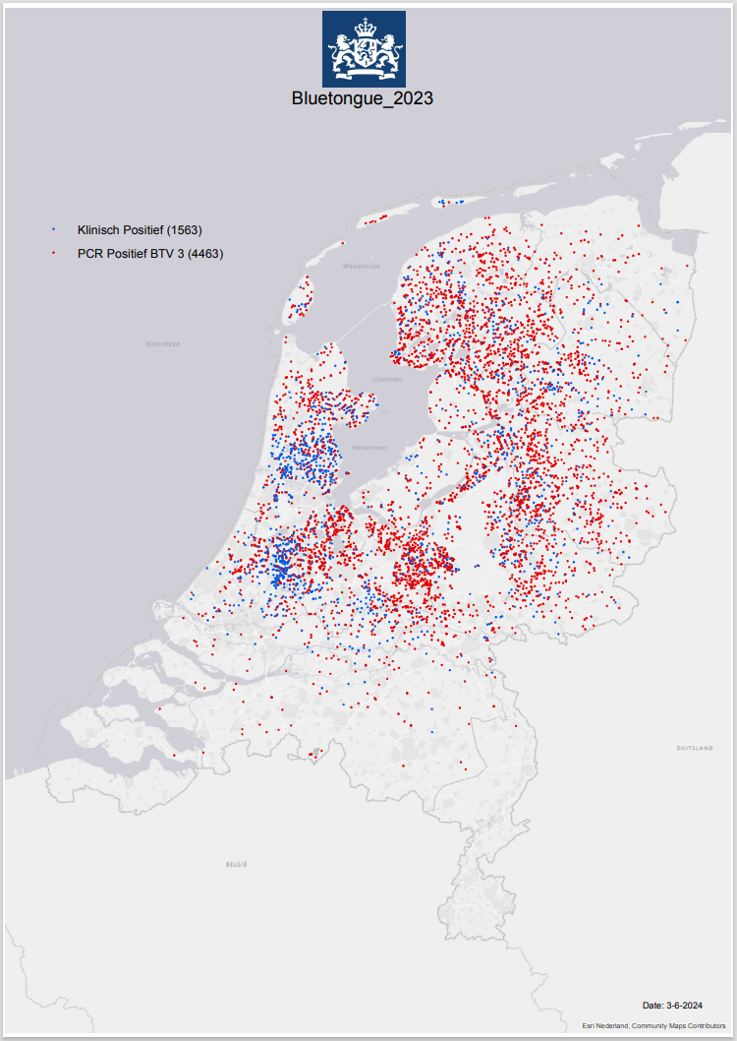
Bluetongue virus (BTV-3) in Europe
Netherlands
First reported Sept 5, 2023
Most recent reports
PCR BTV-3 positives – (4463 Decreased? 5355)
Clinically positive - 1563 (no PCR)
Cases in cattle and sheep
Rare case: 3.5 year old pregnant dog also tested positive
Some cases in lamas/alpacas
Two vaccines for BTV-3 now available
Spanish and German
Notes:
Netherlands first reported the outbreak of BTV-3 in Sept 2023
Most recent counts as of June 3, show 1563 clinically positive and 4463 PCR BTV-3 positive More than 6000 cases
Cases have been reported in both cattle and sheep, one in a dog, and some in alpacas/lamas
Recently two vaccines have become available - one is Spanish and the other German
For the Spanish one Following approval via a fast-track procedure, a total of two million doses will be available to Dutch farmers by the end of April.
Sheep will require one dose, and cattle two doses administered three weeks apart. Animals will be protected approximately 28 days after vaccination, with the duration of immunity is yet to be determined.

Slide 3
Bluetongue virus (BTV-3) in Europe
Belgium
October 10, 2023 case of BTV serotype 3 in sheep in Merksplas
No additional cases reported to WOAH, but a total of 8 on dashboard
1 additional case in late April 2024
Germany
Oct 13, 2023 cases of BTV serotype 3 in Kleve
Cases in both cattle and sheep
As of June 5th, 33 outbreaks reported to WOAH, RA mentions 56
UK
Nov 10, 2023 cases of BTV serotype 3 in cattle in Kent
As of March 1, there have been 123 confirmed cases of BTV in England on 73 premises in 4 counties
116 cases in cattle, 7 cases in sheep
BTV serotype-3 has been found in Kent, Suffolk, Norfolk
No additional reports over the last 3 months in WOAH,
Notes:
Now for other countries in Europe – Belgium, Germany and the UK have reported cases of BTV-3
In this update – Belgium has reported 1 additional case in late April 2024 for a total of 8
Germany has reported additional cases, but totals differ across different systems so anywhere from total of 33-56 outbreaks
And the UK has not reported any additional case in the last 3 months I think they are around ~120 total animals positive – but they have released a risk assessment
And as mentioned on the last update Other countries in Europe are not really doing surveillance if they don't have a market that requires it so there are still a lot of unknowns around BTV-3 distribution in Europe.

Slide 4
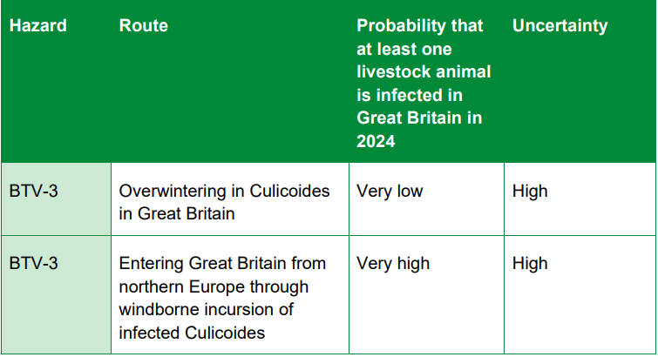
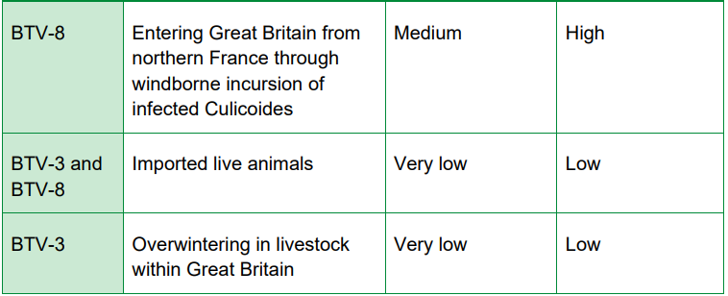
Bluetongue virus UK Risk Assessment (BTV-3 & BTV-8)
There is a very high probability of a new introduction of BTV-3 into livestock in Great Britain through infected biting midges being blown over from northern Europe
Medium probability for BTV-8 through windborne incursion
Very low probability of overwintering of BTV-3 in livestock and in culicoidies – however uncertainty in culicoides is high
Very low probability from imported live animals
Risk assessment for bluetongue virus (BTV-3 and BTV-8): Risk assessment of entry into Great Britain (publishing.service.gov.uk)
Notes:
Now the UK Risk assessment looked at both BTV-3 and a bit into BTV-8
They concluded a very high probability of a new introduction info livestock into great Britain through infected midges being blown over from northern Europe – however with a high uncertainty
A medium probability for BTV-8, through windborne incursion, again high uncertainty
A very low probability of overwintering BTV-3 in the culicoides but with high uncertainty
and very low probability from imported live animals as well as overwintering in livestock

Slide 5
Schmallenberg virus in UK
March 2024
Affected farms in Somerset
High number of cases across the south-west belt of England, from Devon and Somerset through to Herefordshire and Gloucestershire, with
Some farmers reporting 40% of their flock infected
Q fever in the Netherlands
April 2024
Reported on a farm in Gelderland
Re-emergence after ~eight years
Bacteria identified in the sheep farm’s milk tank during regular checks
Other European countries (Bulgaria) have reported increases in both human/animal cases
Notes:
Spread by culicoides - Schmallenberg virus has affected farms in Somerset, with cases rising across the south west. Farmers are reporting a high number of cases across the south-west belt of England, from Devon and Somerset through to Herefordshire and Gloucestershire, with some farmers reporting 40% of their flock infected. Symptoms include: abortions, stillbirths, fetal abnormalities, reduced milk production, fever, and diarrhea.
Q fever – spread by ticks but also aerosol, , caused by coxiella burnetii has been reported on a farm in Gelderland, a re-emergence after ~eight years. The Netherlands last reported Q fever in 2016. According to the ministry, the bacteria were identified in the sheep farm’s milk tank during regular checks and are likely to have come from “one or two” of the 25 young animals that had lambed but have not yet been vaccinated

Slide 6
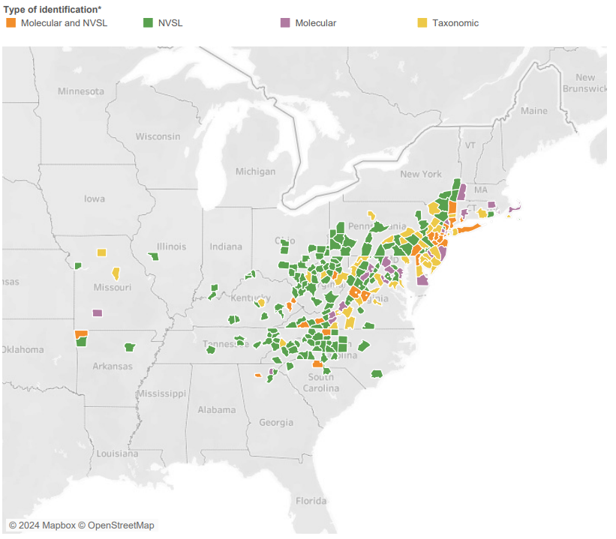
Longhorn Tick and Theileriosis in the USA
Theileria orientalis (ikeda) has been detected in several counties in Missouri
9th state to report the parasite
other states: Virginia, West Virginia, Tennessee, North Carolina, Pennsylvania, Kentucky, Kansas, and New York
Illinois – Morgan county has reported the ALHT
20th state to report the tick
Recent effort to fill in some surveillance gaps with a Tick Blitz around the summer solstice
USDA Haemaphysalis longicornis (Asian longhorned tick) Situation Report

Slide 7
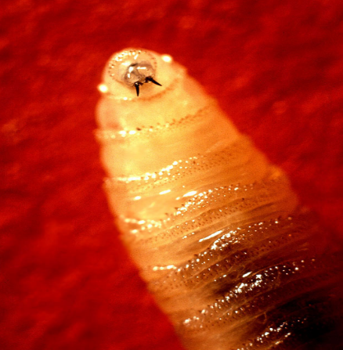
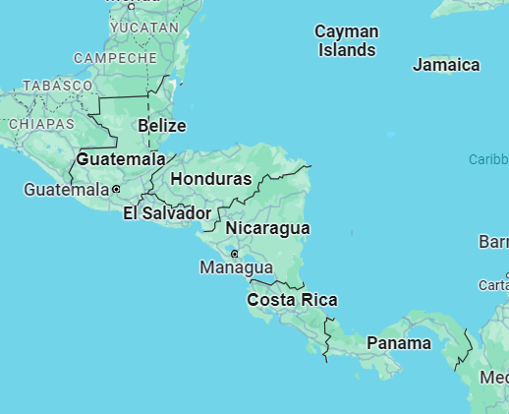
New World Screwworm in South America
Parasitic fly larva - Cochliomyia hominivorax causing wound myiasis
February 2024 – Costa Rica declared a sanitary emergency due to the presence and spread of new world screwworm; 203 cases have been treated in cattle, horses, pigs, sheep, goats and dogs
March 2024 – Costa Rica reported 1st human case
April 3 total human cases
Panama has reported >4,700 cases in cattle and 21 human cases so far this year
Nicaragua declared an animal health alert in April 2024 – has reported >55 cases of (41 cases in cattle, 8 in pigs, 4 in horses, and 2 in dogs), no human cases yet
Mexico is on alert and has increased preventative measures

Slide 8
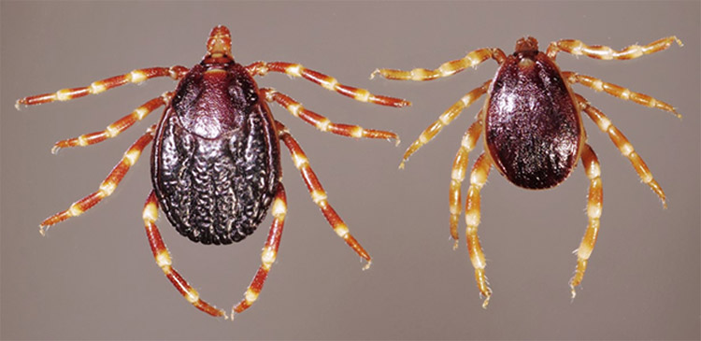
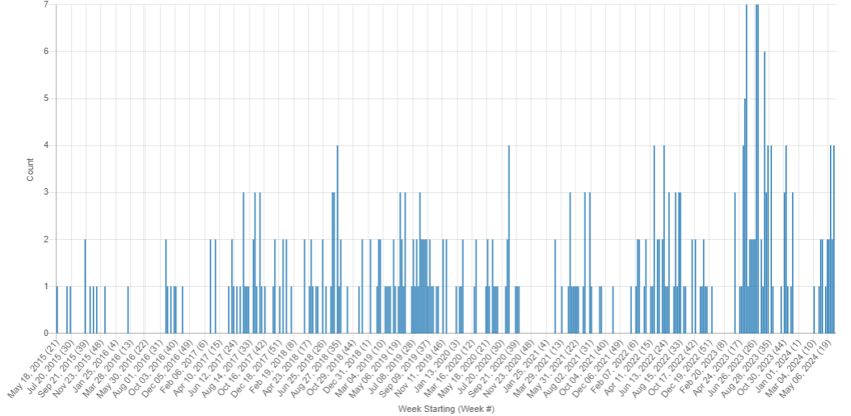
Crimean Congo Hemorrhagic Fever
Cases of CCHF have recently been reported in:
Macedonia (sheep/goats and humans)
France scientific finding - in ticks
Spain (human – elderly man)
Turkey (humans)
Iraq (humans)
Pakistan (humans)
Hyalomma tick (Photo: Daktaridudu/Wikimedia Commons) WHO Eastern Mediterranean Region
Crimean-Congo Hemorrhagic Fever Virus in Ticks Collected from Cattle, Corsica, France, 2023
Animal Exposure Model for Mapping Crimean-Congo Hemorrhagic Fever Virus Emergence Risk
Crimean–Congo haemorrhagic fever virus uses LDLR to bind and enter host cells
CCHF Signals: May 2015 – June 2024
Notes:
CCHF is endemic in Africa, the Balkans, the Middle East and Asian countries south of the 50th parallel north – the geographical limit of the principal tick vector.
Frist study - We report the detection of Crimean-Congo hemorrhagic fever virus (CCHFV) in Corsica, France. We identified CCHFV African genotype I in ticks collected from cattle at 2 different sites in southeastern and central-western Corsica, indicating an established CCHFV circulation
Second study – In Andalusia Spain looked To assess CCHFV exposure spatial distribution, we analyzed serum from 2,440 sheep and goats by using a double-antigen ELISA and modeled exposure probability with environmental predictors by using generalized linear mixed models. CCHFV antibodies detected in 84 samples confirmed low CCHFV prevalence in small domestic ruminants in the region. The best-fitted statistical model indicated that the one of most significant predictors of virus exposure risk were cattle/horse density
There have also been recent report of the hyalomma tick being found in Germany

Slide 9
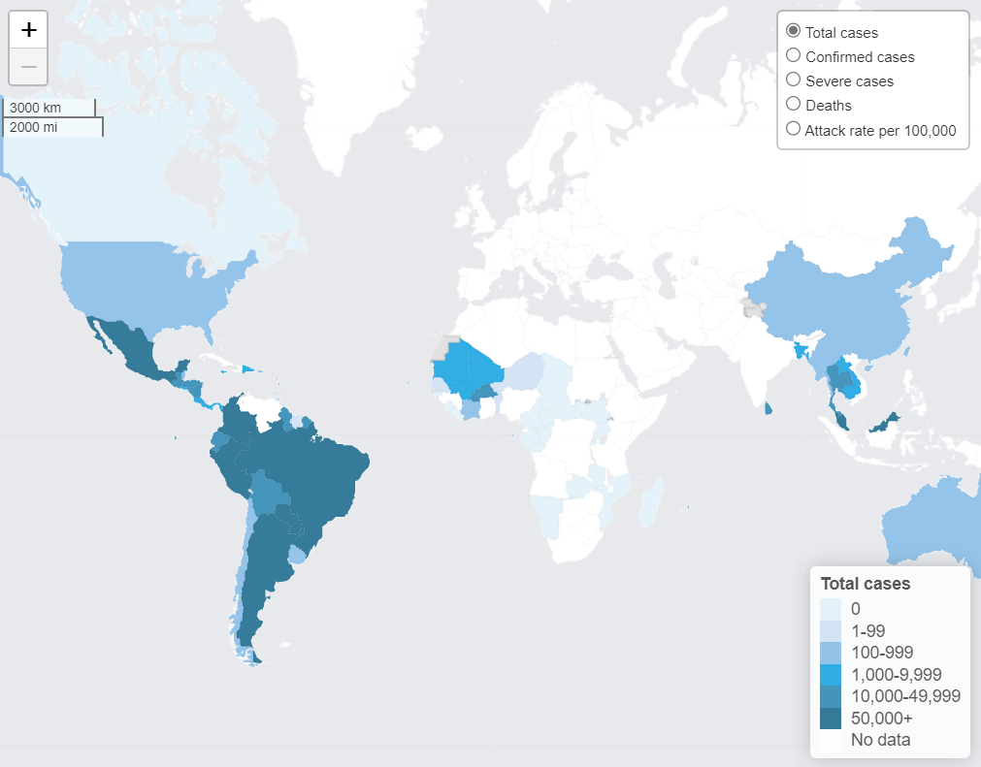
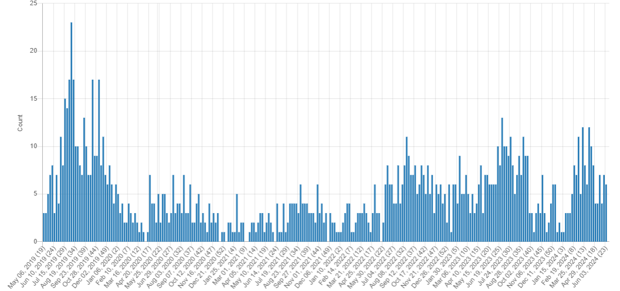
Dengue
PAHO - Dengue Epidemiological Situation in the Region of the Americas
8,794,941 suspected cases of dengue reported in Americas in 20 weeks of 2024
4,264,320 lab confirmed with 4,108 deaths
WHO – Dengue Global Situation
90 countries have known active dengue transmission for 2024
WHO Dengue Dashboard
Dengue Signals: May 2019 – June 2024
Notes:
PAHO - Dengue Epidemiological Situation in the Region of the Americas
8,794,941 suspected cases of dengue reported in Americas in 20 weeks of 2024
Last time I reported on this in March it was almost at 1,9 million
– this is a 231% compared to the same period in 2023 and 425% compared to the average of the last 5 years
4,264,320 lab confirmed with 4,108 deaths (CFR of 0.047%)
- Based on the chart reports/cases do appear to be decreasing the last few weeks
‘
While PAHO focuses mostly on south America – the WHO has recently released a dengue global situation
WHO – Dengue Global Situation
90 countries have known active dengue transmission in 2024, not all of which have been captured in formal reporting
WHO has established a global dengue surveillance system with monthly reporting across all WHO regions with a new dashboard
There is considerable overlap in the geographic distribution of dengue, chikungunya, and Zika viruses, which are all transmitted by Aedes mosquitoes and share some clinical features that can result in misdiagnoses and misreporting in the absence of differential laboratory testing.

Slide 10
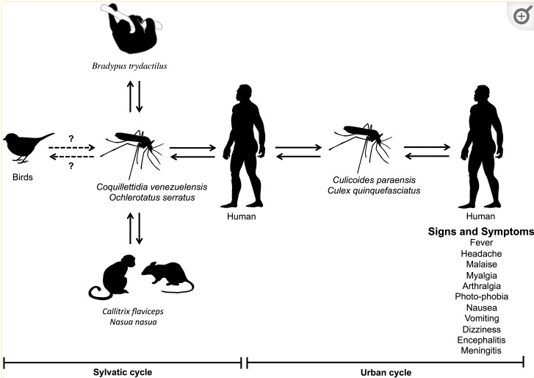
Oropouche virus
PAHO released an epidemiological update on Oropouche virus in the Americas on May 9
Between January 1 to May 4, 2024
Brazil confirmed 4,583 cases
Peru confirmed 259 cases
Bolivia confirmed 313/1856 suspected cases
Colombia confirmed 38 cases (retrospective lab study from dengue surveillance)
French Guiana has confirmed 2/75 cases
Cuba – May 27, 2024 first report in country
Case count is unclear/unstated
Identified during surveillance for nonspecific fever syndromes in Santiago province
Oropouche Virus: Clinical, Epidemiological, and Molecular Aspects of a Neglected Orthobunyavirus
Notes:
On March 6th - PAHO released an epidemiological update on Oropouche virus disease in Brazil and Peru –
Numerous outbreaks of Oropouche virus disease (OROV) have been reported in both rural and urban communities in Brazil, Colombia, Ecuador, French Guiana, Panama, Peru, and Trinidad and Tobago
OROV is mainly transmitted through the bite of the Culicoides paraensis midge that is present in the region, as well as the Culex quinquefasciatus mosquito, which can also be a vector; humans act as the amplifying host
Between January 1 to February 24, 2024
Brazil reported 2,104 samples positive for OROV -1,821 correspond to the state of Amazonas
Peru has reported 146 cases of OROV in the departments of Loreto, Ucayali, and Madre de Dios, the highest number of cases reported to date in this country
Bolivia reported 4 cases
Zika is also spreading - On 29 Feb 2024, the PAHO reported Brazil (867), Colombia (50), Bolivia (27), Peru (6), Costa Rica (6), and Puerto Rico (3) had reported Zika virus cases this year [2024]
Lots of vector borne disease circulating in south America…. Some suggestions linking it to the El Niño phenomenon and climate change (increased temperatures and changes in precipitation)) causing expansion of mosquitos, potentially other vectors

Slide 11
Scientific Findings
Newly Recognized Spotted Fever Group Rickettsia as Cause of Severe Rocky Mountain Spotted Fever–Like Illness, Northern California, USA
Case Series of Jamestown Canyon Virus Infections with Neurologic Outcomes, Canada, 2011–2016
Molecular Epidemiology of Mayaro Virus among Febrile Patients, Roraima State, Brazil, 2018–2021
A naturally isolated symbiotic bacterium suppresses flavivirus transmission by Aedes mosquitoes
Female Aedes aegypti mosquitoes use communal cues to manage population density at breeding sites
A case of tick-borne Yezo virus infection: Concurrent detection in the patient and tick
Molecular epidemiology identifies the expansion of the DENV2 epidemic lineage from the French Caribbean Islands to French Guiana and mainland France, 2023 to 2024
Yersinia pestis can infect the Pawlowsky glands of human body lice and be transmitted by louse bite
Vector competence of Swedish Culex pipiens mosquitoes for Japanese encephalitis virus
Serological prevalence of the Schmallenberg virus in domestic and wild hosts worldwide: a systematic review and meta-analysis
Effects of climate change and human activities on vector-borne diseases
A Scoping Review on the Epidemiology of Orthobunyaviruses of Canadian Public and Animal Health Relevance in the Context of Vector Species

Slide 12
Scientific Findings
Heatwaves are detrimental to fertility in the viviparous tsetse fly
Kyasanur Forest Disease: Clinical manifestations and molecular dynamics in a zoonotic landscape
Isolation and whole-genome sequence analysis of Balagodu virus in Japan
Evidence of Active Orbivirus Transmission in 2016 in Kansas and Nebraska
Increased threat of urban arboviral diseases from Aedes aegypti mosquitoes in Colombia
Towards modelling tick-virus interactions using the weakly pathogenic Sindbis virus: Evidence that ticks are competent vectors
Estimating the effects of temperature on transmission of the human malaria parasite, Plasmodium falciparum
Future malaria environmental suitability in Africa is sensitive to hydrology
Evidence-practice gap analysis in the role of tick in brucellosis transmission: a scoping review
Outbreak of Natural Severe Fever with Thrombocytopenia Syndrome Virus Infection in Farmed Minks, China
Nine-year seroepidemiological study of severe fever with thrombocytopenia syndrome virus infection in feral horses in Cape Toi, Japan

