Slide 1
Community for Emerging and Zoonotic Diseases Signals of Interest for CSHIN
21 November 2024
www.cezd.ca

Slide 2
African Swine Fever Trends
Surge in cases in farmed pigs that occurred in third quarter of 2023 has not occurred in 2024
Still a large number of outbreaks ongoing
African swine fever - WOAH - World Organization for Animal Health
Notes:
The Q3 surge of ASF in domestic swine that we saw last year has not occurred this year.

Slide 3
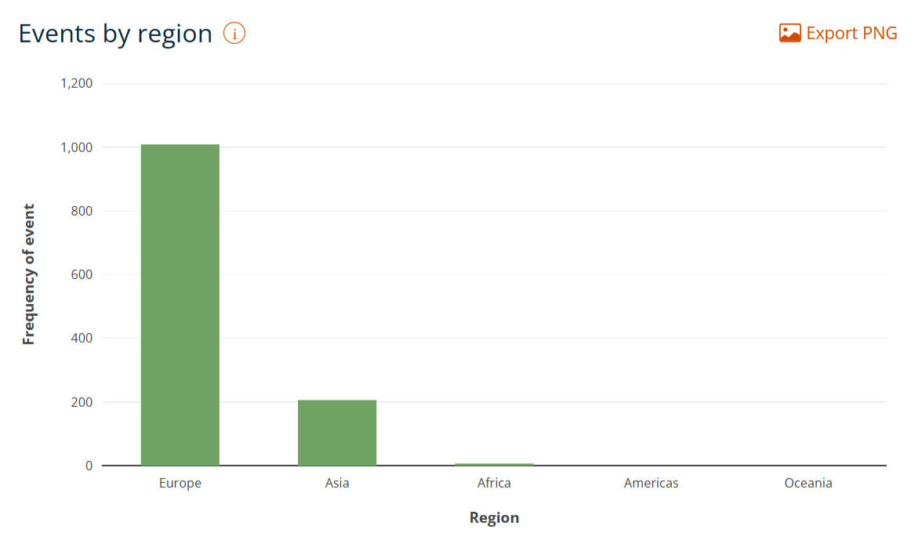
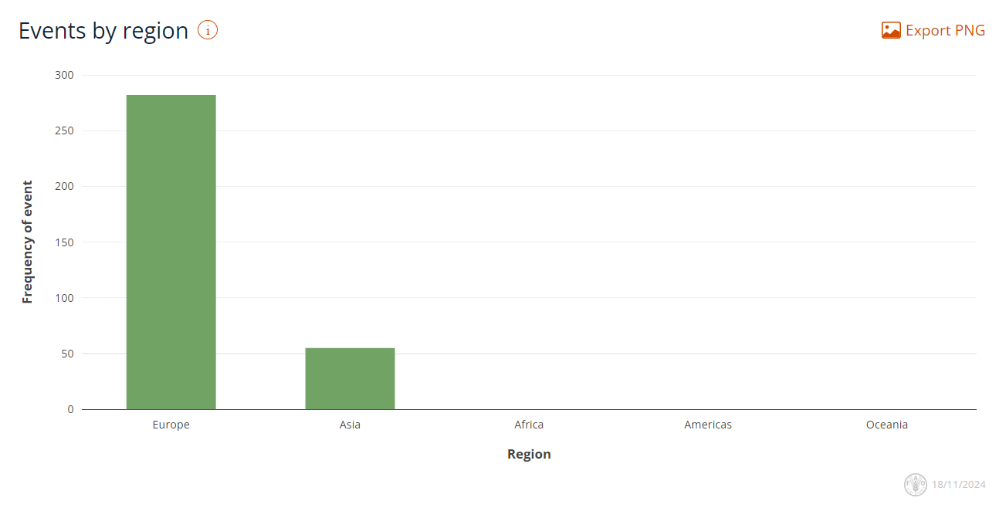
Q3/Q4 ASF Outbreaks by Region
Cases in Europe are reliable numbers
Cases from Asia are significant underestimates as China and India not included in data from Empressi
Q3
Europe (1,009)
Asia (206)
Africa (5)
Q4 to date
Europe (282)
Asia (55)
https://empres-i.apps.fao.org/general
Notes:
We have confidence there are a high number of cases continuing in Europe, but China and India are not reporting cases routinely to WOAH, yet we see evidence of ASF cases in media reports and scientific findings from those countries. India has ASF included in its 6 monthly reports but hasn’t uploaded anything since 2nd trimester of 2023. China does not include cases in its 6 monthly reports, and it indicates its last detections were in 2021.

Slide 4
Notable ASF Cases - Europe
German cases in Hessen close to the French border (domestic and wild cases)
Genotypes from Southeastern Europe not Eastern Germany
France has increased surveillance and is considering building a fence to keep out wild boar
Poland has the highest number of cases, mostly in wild boar
Ukraine manages to keep reporting when they are under constant siege
Wild Boar
Domestic Swine
Q3
https://empres-i.apps.fao.org/general

Slide 5
ASF Freedom - Europe
Q3
Sweden made a self-declaration of freedom of ASF in all suids to WOAH
The case reported in July of 2024 was from a wild boar thought to have died almost a year earlier
Notes:
Sweden | September 24: the European Commission officially recognized Sweden as free
from ASF, a year after the disease was first detected in a wild boar in Västmanland
county. The country reported its first ASF case on September 6, 2023, involving a wild boar
near Fagersta, approximately 90 miles (150 km) northwest of Stockholm. In response, a
comprehensive campaign was initiated, costing nearly $11 million (€10 million). Authorities
identified 70 infected wild boars in the region and euthanized 116 to prevent further spread. As
of late September 2023, no additional infected wild boars have been reported. No farms were
affected. With this declaration, Swedish authorities are set to lift the infection zone and all
remaining restrictions.

Slide 6
ASF Freedom - Europe
The European Commission has recognized Sardinia free of ASF Genotype I (both wild boar and domestic swine)
Genotype I (endemic in Africa) introduced to Sardinia in 1978
Required collaborative efforts across society: farmers, local communities and law enforcement
Eradication required intense surveillance, biosecurity measures, + training for farmers and hunters
SHIC Global Disease Monitoring Reports – Swine Health Information Center October 2024 Report
Q3
Notes:
On September 24, the European Commission officially recognized Sardinia
as free from ASF genotype I, following a successful eradication campaign that began after
the disease was first detected on the island in 1978. Genotype I is considered endemic in
Africa and differs from genotype II, currently circulating in Europe. Sardinian authorities
praised the collaborative efforts of farmers, local communities, and law enforcement in
achieving this milestone. The eradication strategy involved strict surveillance, biosecurity
measures, and training for breeders and hunters. Officials emphasize the importance of
continued vigilance to prevent a resurgence of the disease, especially as ASF remains a
significant threat in other regions of Italy and Europe.

Slide 7
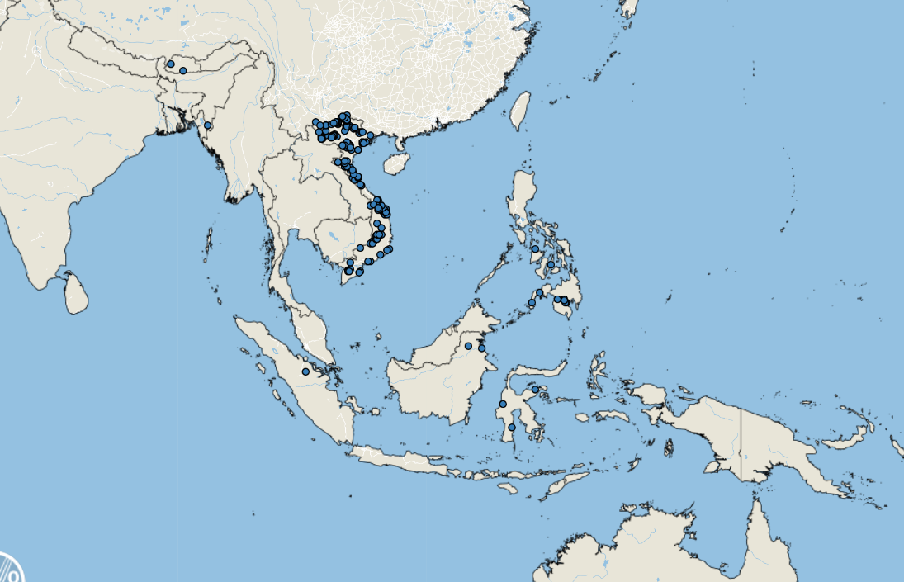
Notable ASF Cases - Asia
Q3
Vast majority of cases in Q3 and Q4 to date reported from Vietnam

Slide 8
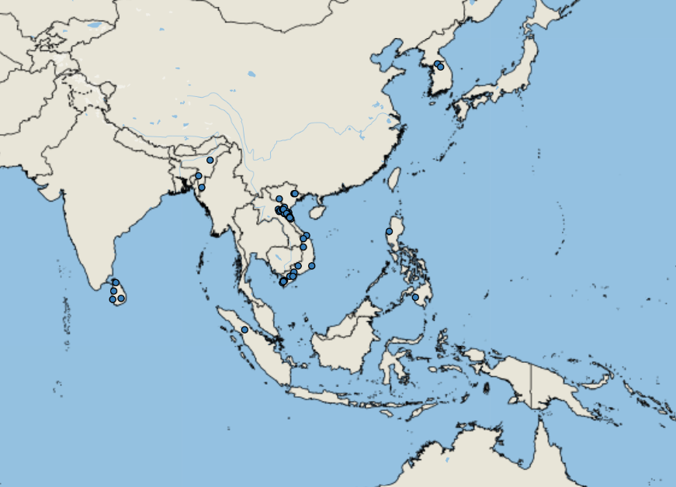
Notable ASF Cases - Asia
Q4 to date
Q4
Sri Lanka – 1st Detection
Detections in India not being reported to WOAH immediately but are in the news routinely (esp Mizoram)
Many other Asian countries not making immediate reports to WOAH including China (some include in 6 monthly reports)
Notes:
India does have ASF in their 6 monthly reports to WOAH, but they are behind in reporting – 1st report for 2024 is not yet available.
Example of Indian case being reported in media
India | August 30: ASF was detected in Thizama village in the Kohima district of Nagaland state.
Government officials designated a 1 km radius around the village as an infected zone and a
surveillance zone covering an additional 9 km outside the infected zone. They also banned animal
transport to slaughter and pigs' importation and exportation (no information was made available
regarding pork products).
ASF continues to cause financial devastation in Mizoram, as 10,050 pigs have died and 18,300 pigs
have been culled since February, although the Mizoram Animal Husbandry and Veterinary Department
has reported that ASF-related pig mortalities have reduced recently. Financial losses in Mizoram are
estimated between USD $2.75 and $3.0 million.

Slide 9
ASF Freedom - Taiwan
Q4 to date
Q4
Self-Declaration of Freedom made to WOAH
Domestic pigs and Wild Boars
Notes:
Taiwan | November 1: officially recognized by the WOAH as ASF-free, marking it as the second
country in East Asia, alongside Japan, to achieve this status. The Ministry of Agriculture
highlighted that the ASF-free designation will enhance Taiwan’s pork industry by expanding export
opportunities. Taiwan previously achieved freedom from FMD in 2020 and has applied for CSF-free
status, with a decision anticipated in May 2025. Taiwan successfully prevented ASF outbreaks through
stringent border controls and biosecurity measures, promoting sustainable growth in its livestock
sector.

Slide 10
Genotype II Live-Attenuated ASFV Vaccine Strains Unable to Completely Protect Pigs against the Emerging Recombinant ASFV Genotype I/II Strain in Vietnam - PubMed
In 2021, recombinant ASF Viruses (rASFV I/II) containing genetic elements from genotype I and II ASF viruses emerged in China
2023 Cases rASFV I/II found in Northern Vietnam and in Russia’s Primorsky region
Close to borders with China
Vietnam has 2 licensed live attenuated vaccines against ASF
Pigs vaccinated with approved vaccines, when challenged with rASFV I/II, succumbed to the infection, or developed signs of chronic ASF.
Important as we had hoped the vaccines would decrease the level of virus circulating globally, resulting in a decreased introduction risk for Canada
Notes:
Scientific Study of the effectiveness of the existing ASF vaccines in Vietnam against the new recombinant virus that emerged from China in 2021.

Slide 11
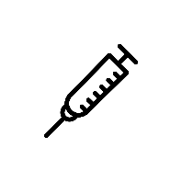
Genotype II Live-Attenuated ASFV Vaccine Strains Unable to Completely Protect Pigs against the Emerging Recombinant ASFV Genotype I/II Strain in Vietnam - PubMed
Control group = PBS
Vaccine (IM) ASFV-G-ΔI177L
Vaccine (IM) ASFV-G-ΔMGF
3 groups of 6 pigs
8 week old Yorkshire-Landrace-Duroc crossbred
Negative for ASF, PCV2, FMD, CSF, PRRS (molecular testing)
Negative ASF serology
Groups separated and allow to acclimate 1 week
Vaccinated
Notes:
Nasal swabs, serum, and whole blood samples from each pig were collected at 0, 7, 14, 21, and 28 days post-vaccination
(dpv). For sample collection, each pig was restrained using a snare. After the sample
collection on 28 dpv, all pigs were challenged IM with rASFV I/II at 103 HAD50 in 1 mL
per pig.

Slide 12
Genotype II Live-Attenuated ASFV Vaccine Strains Unable to Completely Protect Pigs against the Emerging Recombinant ASFV Genotype I/II Strain in Vietnam - PubMed
0 7 14 21 28
Monitored for 28 days post vaccination, swab, serum and whole blood collected q7days for 28 days
Control pigs remained healthy
Fever apparent in several pigs ASFV-G-ΔI177L group, with one death at day 7
One pig had a mild fever after vaccination with (IM) ASFV-G-ΔMGF
Day 28, challenged with the recombinant ASF virus

Slide 13
Genotype II Live-Attenuated ASFV Vaccine Strains Unable to Completely Protect Pigs against the Emerging Recombinant ASFV Genotype I/II Strain in Vietnam - PubMed
Control
All either found dead or
Euthanized by day 6
ASFV-G-ΔI177L
0 4 7 14 21 28
1 found dead day 9
1 found dead day 18
1 euthanized day 19
2 survived, developed chronic ASF
ASFV-G-ΔMGF
Humane end points reached
2 euthanized day 6
2 euthanized day 7
2 euthanized 8
Pigs vaccinated with ASFV-G-ΔMGF or ASFV-G-ΔI177L, when challenged with rASFV I/II, succumbed to the infection, or developed signs of chronic ASF.
Notes:
After the challenge, pigs continued to be monitored twice daily for clinical signs (fever,
anorexia, depression, skin discoloration, staggering gait, cough, constipation, and diarrhea),
and rectal temperatures were measured daily throughout the experiment. Nasal swabs,
serum, and whole blood samples were collected at 4, 7, 14, 21, and 28 days post-challenge
(dpc). Rectal temperatures above 40 degrees for 2 consecutive days were considered
fever. Any pig reaching the humane endpoint was euthanized using 10 mL of sodium
pentobarbital (240 mg/mL) intravenous injection. Any animal found dead or euthanized
was subjected to a full postmortem examination, and tissues were collected for virus
detection. A clinical scoring system developed in-house (Supplementary Materials Table S1)
was used to record the daily clinical findings for each animal.

Slide 14
Two pigs that had been vaccinated with ASFV-G-ΔI177L and survived developed chronic ASF signs
Hope for vaccination to control ASF is threatened, as recombinant strains will replace genotype II where vaccination has occurred
Important because the international risk of ASF will remain high

Slide 15
Foot and Mouth Disease – Hazard Trend
SAT-2 in middle east
Hazard trend line has returned to baseline after spike due to SAT-2 in the middle east last year
COVID
FMD Indonesia
Notes:
Hazard trend line has gone back to baseline from last year when we were sharing information on SAT-2 in the middle east.

Slide 16
FMD Cases
20 cases in Q3
17 Africa
S. Africa SAT-3
Mozambique SAT-1 + unidentified
3 Asia
China O + unidentified
Turkey A
10 so far in Q4 Asia
Indonesia unidentified
China O
Notes:
20 outbreaks in Q3
17 in Africa
South Africa SAT3
Mozambique SAT1 + unidentified
3 in Asia
China O and unidentified
Turkey A
~10 so far in Q4
Indonesia unidentified type
China just reported type O in swine at the slaughterhouse

Slide 17
Notable FMD Cases Q3
Serotype A in Türkiye (1st time in 6 years)
SAT-2/XIV no new countries but, ongoing cases in Turkiye and Iraq, but no new countries
Frequent movements from Pool 4 to 3
Reference Laboratory Reports | World Reference Laboratory for Foot-and-Mouth Disease

Slide 18
Vaccine for foot and mouth disease a win for East Africa
The vaccine was developed as part of the AgResults Vaccine Challenge Project,
An eight-year, US$17.34 million “pay-for-results” prize competition, organized by the livestock charity GALVmed
The quadrivalent vaccine, manufactured by Biopharma based in Morocco
Vaccine against O, A, SAT1, and SAT2 – that are known to be circulating in Eastern Africa.
It the first quadrivalent vaccine against FMD to be registered in the region.
Any decrease in FMD activity in endemic areas means the global viral load will be decreased and our own introduction risk will lessen
Notes:
Funded by the governments of Australia, Canada, the United Kingdom, and the United States, as well as the Bill & Melinda Gates Foundation, the project is structured as a cost-share that reduces the cost-per-dose for buyers.

Slide 19
HPAI in 2 pigs in Oregon
Small Farm
Pigs cohoused with poultry, shared equipment, water etc…
5 pigs on the site (all destroyed)
No clinical illness
2 confirmed positive with low viral load
Genotype D1.2 from wild birds in the surrounding area
H5N1 Risk to Swine Podcasts – SHIC Talk – Swine Health Information Center
Included more information on the case in the Oregon swine
Important to understand H5N1 and its ability to infect mammalian species
Any species infected with multiple influenza strains can result in new reassortant viruses

Slide 20
Human - Influenza A(H3N2)v Canada (Saskatchewan)
New human case of swine origin Influenza A in SK
Child <18 years old
Decreased appetite
Arthralgia
Dizziness
Fatigue
Otitis
Rhinorrhea
Nasal congestion
Sore throat
Was not hospitalized
Fully Recovered
No known exposure to symptomatic people or animals prior to illness
Lives on a farm with livestock without direct contact reported
No symptomatic livestock on the farm
While cases are rare in Canada, they remain important for worker safety
Humans spread Influenza to pigs more often than pigs transmit influenza to humans!
Notes:
One new human case of swine origin influenza A(H3N2)v was reported in July 2024 from Canada.
The case was a child (< 18 years old) from Saskatchewan, Canada. On June 10, 2024, the case developed symptoms including decreased appetite, arthralgia, dizziness, fatigue, otitis, rhinorrhea, nasal congestion, sore throat, and sputum production. On June 16, 2024, the case sought emergency medical care. The case was not hospitalized and has since recovered. Public health officials found no known exposure to symptomatic persons or animals prior to symptom onset. The case lives on a farm with cattle and swine but reported no direct contact with the livestock. There are no reports of symptomatic cattle or swine on the farm, nor symptomatic contacts of the case.

Slide 21
Swine Influenza Cases in Humans (Human Variant Influenza A Cases)
USA
H1N1v in Ohio
H1N2v in Pennsylvania
Both patients >18 yrs
Developed symptoms in August
Reported exposure to swine
Briefly hospitalized and recovered
USA
H3N2v – Colorado
<18yrs had attended an agricultural fair
H3N2v – Michigan
Details unknown
Vietnam H1N1v
70 year old female
Underlying medical conditions
Developed pneumonia, passed away
Source of exposure unknown

Slide 22
Scientific Findings
Full article: Spatial patterns of influenza A virus spread across compartments in commercial swine farms in the United States
Exploring Potential Intermediates in the Cross-Species Transmission of Influenza A Virus to Humans
APHIS Veterinary Services Publishes Revised 2024 Japanese Encephalitis (JE) Disease Response Strategy | Animal and Plant Health Inspection Service
Isolation and characterization of Leptospira licerasiae in Austrian swine - a first-time case report in Europe – PubMed
Characterization of three African swine fever viruses from different clinical settings revealed a potential attenuation mechanism | Animal Diseases | Full Text
Reverse zoonosis of the 2022–2023 human seasonal H3N2 detected in swine | npj Viruses
Modeling the transmission dynamics of African swine fever virus within commercial swine barns: Quantifying the contribution of multiple transmission pathways | bioRxiv
Integrating Systematic Surveys With Historical Data to Model the Distribution of Ornithodoros turicata americanus, a Vector of Epidemiological Concern in North America
Novel Porcine Getah Virus from Diarrheal Piglets in Jiangxi Province, China: Prevalence, Genome Sequence, and Pathogenicity

